Slide 1

National Institute of Buisness & Management Kandy Diploma in Software Engineering 24.2f Final Project Proposal Presentation Health Guard AI-Detection System Presented By D.G.C Minidu KADSE24.2F-004 W.A.S Soysa KADSE24.2F-002 K.M.H.K Bandara KADSE24.2F-049 Ravidu Wickramasinghe KADSE24.2F-041

Slide 2
Health is a vital sector that has uprisen with modern trends and more evaluating demands in recent society. Technology has enhanced to make AI related components in the Health Sector as well. This Project will aim to address the usage of machine-learning concepts to derive the potential threats based on user data including blood Pressure, Blood Oxygen Level and Heart Rate of the Patients. By using a model to determine if the patient is at “RISK” or “HEALTHY” we can get clear insights for Precaution.
Brief Overview of the project
Problem Statement
Many individuals who are using the Health Services lacks the immediate access to their medical records, leading on to a delayed detection of the high potential risk. Without the timely intervention, conditions such as hypertension, hyperoxia, or abnormal Heart rates can go unnoticed, increasing the risk of severe health complications. There is growing a need to diagnose chronic Health conditions like cardiovascular and respiratory diseases that goes quite unnoticed within the modern days. The Traditional Health checkups require the in-person assessments and it is not quality controlled and assured within the modern sophisticated Society. So, there is a need for an AI-driven Solutions.
Solution
Development of an Application to analyze the disease of patient by primary vitals like Blood Pressure, Heart Rate, Sugar-level and other mandatory bio-information
Devolopment Format

Slide 3
Devolopment Format
Machine Learning Model
1.Logical Regression Model
2.Advanced models for Experimentation
3.Age,BMI, Cholesterol levels & Life Factors are considered for Engineering
01
04
Future Enhancements
System Architecture
1.Devoloping a mobile phone application
2.Implementing real time monitoring features by IOT
3.Expanding the areas of health-alert tracking
1.Front-End
2.Back-End API
3.Database
4.Security
Deployment & Integration
1.Cloud Computing
2.API Devolopment
3.Real-Time Alerts
02
03

Slide 4
Expected Outcomes
Improved Accuracy in Health Risk Prediction through learning process.
Deployment of secure system for a broader health Care
A functional AI-Driven Health assesment tool accesible via web application
Seamless Integration with medical records

Slide 5
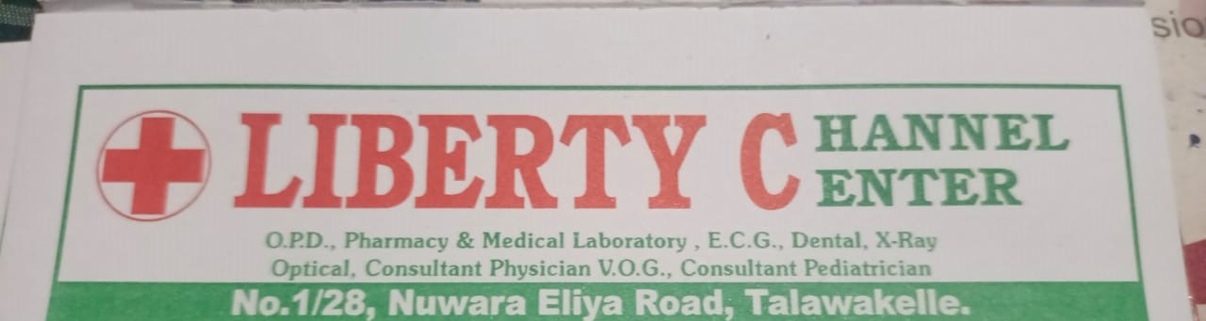
Introduction of the Organization
Liberty Channel Center is an innovative Health Care unit within the Suburbs of Thalawakelle in the Nuwara Eliya District. This Health-Care Unit Consists with an O.P.D Unit, Pharmacy & Medical Laboratory Services, E.C.G., Dental, X-Ray, Optical & Other Medical Professionals like Consultant Medical V.O.G’s attend to this Health Care unit to provide Services to the General Public. This Health-Care unit aims in providing Health care services by integrating with the new technology monitoring into its operations to entrust the patient care and reduce emergency hospital visits. Usage of Digital Technologies will make the services provided more efficient for this medical center.

Slide 6
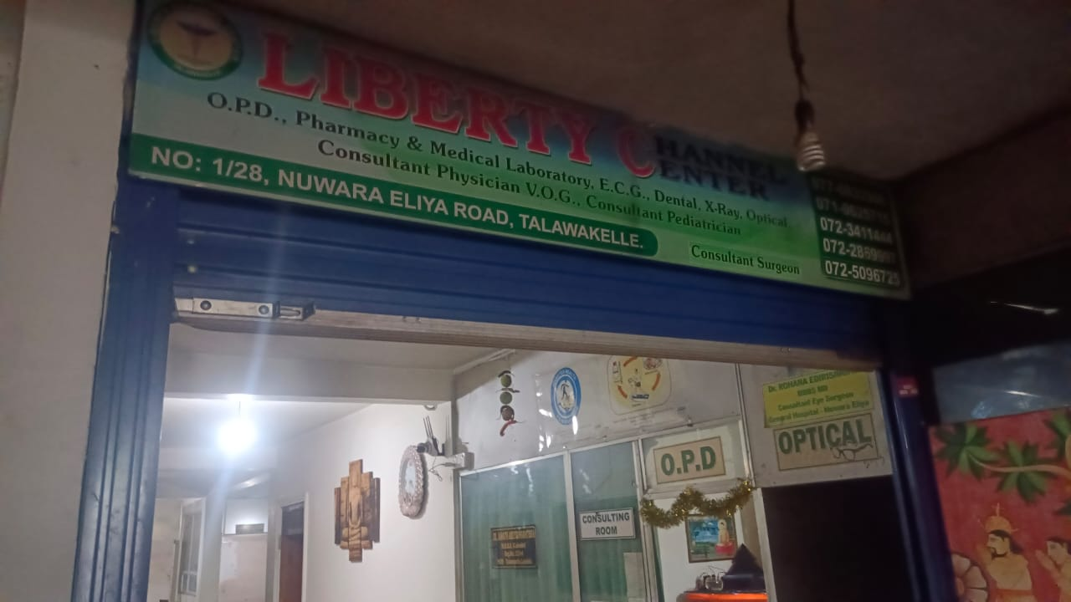
Current Operations in Organization
Currently the Liberty Channel Center relies on manual methods to patient checkups and the electronic health records are to track the patient vitals are kept track on a PC. However, there is no real time monitoring for the process, instead risks are determined by the historical patient data rather than the provocative patient data analysis. This leads to delayed diagnosis in the diseases and limited preventive care interventions. Since the Majority of the People in the Talawakelle are Indian Tamils who are workers of neighboring tea estates, they frequently access the medical services from this Health-Care Unit. Provision of Medical Records are high for this type of Medical Health Care Unit so Machine learning records can be easily retrieved.

Slide 7
Problem Definition
The lack of real-time health monitoring and risk prediction tools in Healthcare Systems in Sri Lanka has led to increased emergency hospital admissions due to preventable health conditions. Without an AI-based solution, patients and doctors rely on reactive rather than proactive healthcare interventions.

Slide 8
Project Objectives
Objective 2
Objective 4
Deploying the system online for easy accessibility and for remote health monitoring purposes.
Creating a user-friendly web or mobile application for data input and results visualization.
Integration of wearable devices (smart-watches) for real-time health tracking.
Development of a machine learning model to predict the health risks
Objective 1
Objective 3

Slide 9
Proposed Solutions
The proposed AI-based health prediction system will use machine learning to analyze patient information and predict potential health risks in real time. The system will allow users to input data manually via a web or mobile app or automatically sync data from wearables. Predictions will be displayed on a user-friendly dashboard, providing instant insights to both patients and healthcare providers. The model will continuously improve as more patient data is collected. Since this Medical Health Care Unit is located in Talawakelle most patients are being the tea-estate workers they visit this unit to get accurate medical services for their illnesses. Language barrier is present for most of the patients those who attend to this Health Care Unit So usage of a machine learning model to submit their medical records in a desirable language.

Slide 10
Methodology
This Section will outline the methodologies that we used in designing and implementing the health prediction system. It describes the approach taken for data collection, software development, testing strategies, and project planning. This methods ensure the system's accuracy, security, and usability while maintaining records with medical data regulations the System.
Data Collection Methods
Step 01
Manual Data Entry (Basic Approach)
Step 02
Wearable Devices & IoT Sensors
Step 03
Hospital & Clinic Databases (Professional Use)

Slide 11
Software Process Model
The Agile Software Development Model is adopted due to its flexibility and iterative nature. The project follows Scrum methodology, which includes:
User Feedback Integration
Adjustments based on feedback from healthcare providers and patients.
Sprint Planning
Define development tasks and set sprint goals
Frequent Testing
Continuous evaluation to ensure functionality and performance
Incremental Development
Regular releases of system features in small, manageable iterations

Slide 12
Software Development Tools
Devolopment Environments
Machine-Learning Libraries
✅ Visual Studio Code – Lightweight code editor suitable for Python, PHP, and JavaScript.
✅ Visual Studio – Ideal for developing enterprise applications, especially with .NET.
✅ Google Collab – Cloud-based Jupiter Notebook for quick ML experiments
✅ scikit-learn – Essential for building ML models like Logistic Regression.
✅ TensorFlow / PyTorch – Advanced deep learning frameworks.
✅ XGBoost / LightGBM – High-performance gradient boosting frameworks.
Programming Languages
Web Development Framework
✅ Laravel – PHP framework for backend API and database management.
✅ Django – Alternative Python framework with built-in security.
✅ React.js – Frontend UI framework for web applications.
✅ Python – Core language for machine learning.
✅ PHP – Backend development for handling web services and database operations.

Slide 13


Slide 14
Testing Strategies
To ensure system accuracy, performance, and security, the following testing strategies are applied:
01
02
03
04
05
Integration Testing
Security Testing
Machine Learning Model Evaluation
Unit Testing
Performance Testing
Tests individual components such as the ML model, database operations, and API requests using PyTest or Unittest.
Ensures proper communication between frontend, backend, and databases.
Evaluates system speed and load handling using JMeter.
Ensures data privacy by testing against SQL Injection, Cross-Site Scripting (XSS).
Model accuracy is tested using classification metrics like precision, recall, F1-score, and ROC-AUC curve.

